Slide 1



DEPARTMENT OF COMPUTER SCIENCE AND ENGINEERING
MK SENTINEL IOT BASED FIRE AND GAS PREDICTION SYSTEM
PONMANI S
Assisstant PROFESSOR (SG)
220701117 KAMAL J R
220701524 MANOJ KUMAR J

Slide 2
INTRODUCTION
  Smart multi-sensor sensing: MQ‑2 (gas/smoke), MQ‑6 (LPG), YG1006 (flame), DHT11 (temperature) on Arduino + ESP8266 for real time home ready monitoring.
  Predictive safety with ML: a light Decision Tree foresees danger from context and patterns, reducing false alarms and enhancing early warnings.
  Rapid, concise alerts: React web dashboard with color‑coded statuses, live gauges, and trend history for immediate situational awareness.
  Local-first reliability: Operates on home Wi‑Fi with resilient offline behavior; vital alerts continue even if the network goes down.
  Multilingual and accessible: UI and alerts customized for Indian homes, with regional language support for inclusivity.
  Open, affordable, extensible: Low BOM cost, open source stack, modular hardware, and code for simple customization and scalability.
  Future ready roadmap: Built to incorporate automated interventions (e.g., certified gas shutoff) and cloud analytics when needed.
Second Review
Department of Computer Science and Engineering
2

Slide 3
PROJECT OVERVIEW
  Provide a cost-effective, trustworthy IoT safety solution for Indian households that monitors LPG leaks, smoke, open flame, and unusual heat in real time with MQ-2, MQ-6, YG1006, and DHT11.
  Transition from reactive alarms to proactive safeguarding by anticipating perils in advance with a light weight Decision Tree model minimizing false alarms and enhancing response confidence.
  Offer a clean, readable user interface through a React dashboard with color-coded statuses, real-time gauges, trends, and multilingual alerts appropriate for varied households.
  Combine multi sensor inputs (gas, smoke, flame, temperature) on Arduino + ESP8266 for continuous acquisition and robust on-device processing.
  Deploy a lightweight Decision Tree classifier (trained on normal/warning/danger labeled data) for early detection of anomalies and context based risks.
  Stream categorized readings to a backend and display live insights on a React web dashboard with thresholds, trends, and alert history.
Second Review
Department of Computer Science and Engineering
3

Slide 4
EXISTING SYSTEM
  Commercial LPG wall detectors (Vighnaharta TS12CLR-EX-LEL, flameproof, RS485/Modbus, %LEL display, relays): hardy but fixed threshold, single-use, industrial cost, very little home UI or predictive reasoning.
  Consumer Wi‑Fi gas alarms (Tuya/SmartLife, Connex, Sonoff): app notifications and optionally linked valve, but limited sensor fusion, thin analytics/history, and susceptible to nuisance alarms without context aware ML.
  Combined smoke/CO home alarms (NFPA referenced, composite detectors limit false alarms): suitable for smoke/CO, but usually don't include LPG detection and don't have multi modal kitchen context along with real-time dashboards.
  Fuse multi sensor data (gas, smoke, flame, temperature) on Arduino + ESP8266 for ongoing acquisition and robust on device processing.
  Use a light Decision Tree classifier (trained on labeled normal/warning/danger data) to identify early anomalies and context based risks.
  Stream structured reads into a backend and display real time insights on a React web dashboard with thresholds, trends, and alert history.
Second Review
Department of Computer Science and Engineering
4

Slide 5
PROBLEM STATEMENT
  Problem: Home LPG leaks, smoky buildup, open flame, and excessive kitchen heat commonly go unnoticed until it is too late, resulting in avoidable injuries, fatalities, and property damage in Indian households.
  Context gap: Typical household alarms are single use, threshold-only, and buzzer-based, providing no predictive analysis, remote sensing, or context aware nuisance alarm suppression during routine cooking.
  Technical necessity: A locally dependable multi sensor, network aware system that integrates gas, smoke, flame, and temperature signals, examines patterns, and provides timely, intelligible signals to citizens.
  Social need: Early detection reduces deaths, hospitalizations, and costs, facilitating safer use of LPG and enhancing confidence in clean cooking programs for urban and rural homes.
  Feasible impact: A low cost, open, and flexible solution can be instantiated at scale, equipping families with active protection and facilitating eventual integration with certified shut-off solutions and smart home systems.
Second Review
Department of Computer Science and Engineering
5

Slide 6
OBJECTIVES AND SCOPE
Existing solutions on the market for gas and fire detection include commercial LPG gas leak detectors, such as the TS12CLR-EX-LEL, which offer high-quality flameproof hardware and threshold alarms. However, these solutions are costly and lack user-friendly interfaces or predictive intelligence. Consumer-based Wi-Fi gas alarms, such as the Tuya SmartLife and Sonoff detectors, have remote notifications and limited connectivity but incur high rates of false alarms due to a lack of multisensor fusion or machine learning context awareness. Interlinked smoke and carbon monoxide detectors for residential use successfully minimize false alarms for smoke, but fail to include LPG leak detection or full kitchen hazard monitoring. These shortcomings leave a space for a cost-effective, multi-sensor, predictive, and simple to use solution specific to Indian homes, which MK Sentinel can meet by integrating multiple sensors, ML based risk prediction, and a real-time dashboard with multilingual alerts.
Second Review
Department of Computer Science and Engineering
6

Slide 7
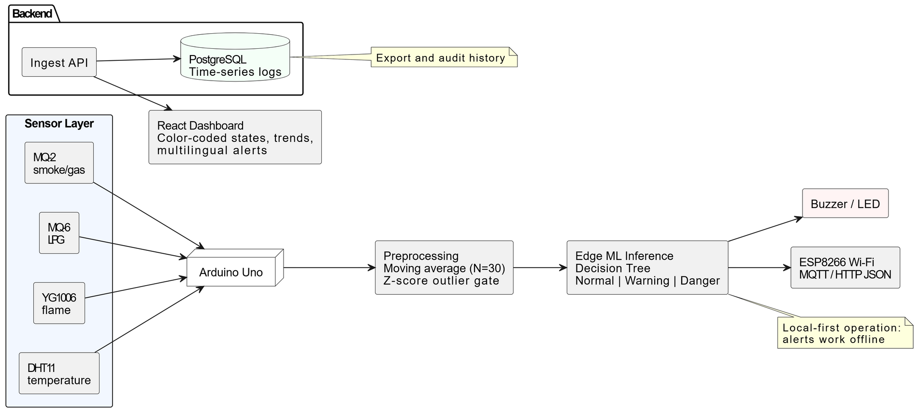
System Architecture
Second Review
Department of Computer Science and Engineering
7

Slide 8
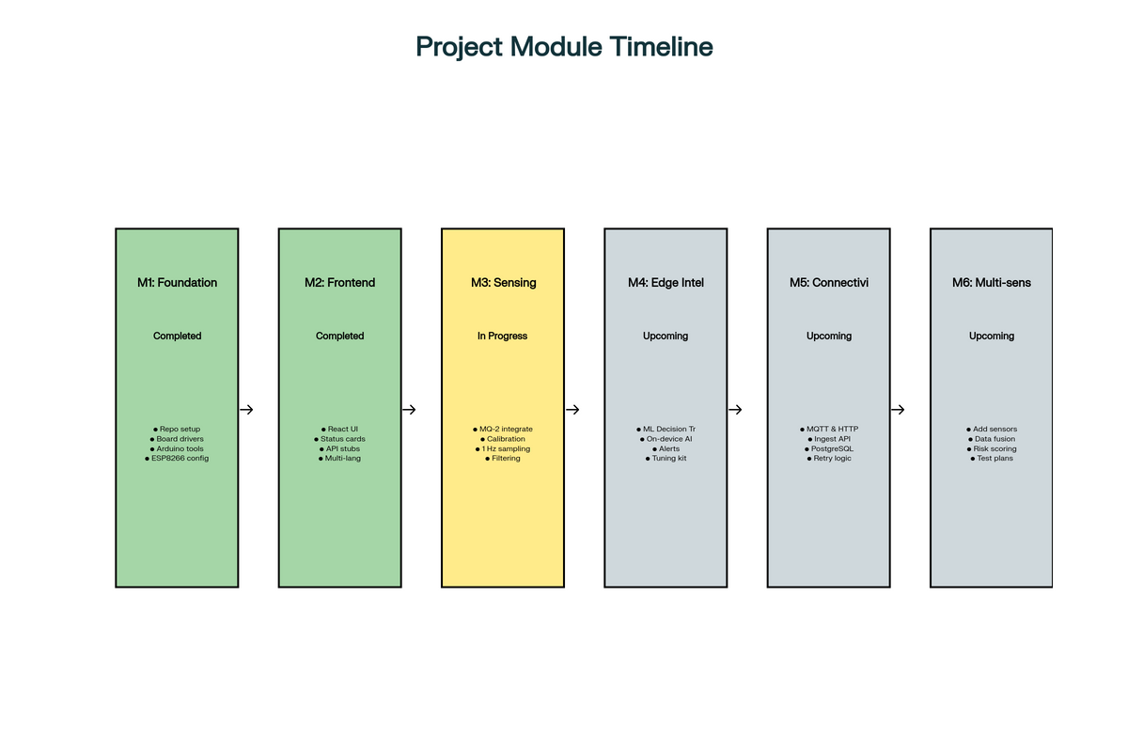
List Of Modules
  Module 1 - Foundation
  Module 2 -Frontend
  Module 3 - Sensing
  Module 4 - Edge Intelligence
  Module 5 - Connectivity and Data
  Module 6 - Multi‑sensor Expansion
Second Review
Department of Computer Science and Engineering
8

Slide 9
LITERATURE SURVEY
Author(s) / Year | Title of the Paper | Methodology / Approach | Inference
Engineering Technology & Applied Science Research / 2020 | IoT Gas Leakage Detector and Warning Generator | Industrial IoT monitoring using MQ-5 gas sensor with Arduino UNO, cloud data posting, automatic alarm systems with LCD display and exhaust fan activation. System detects LPG leakage under atmospheric conditions with wireless communication capabilities. | Demonstrated effective Arduino-based industrial IoT gas leakage detection using MQ-5 sensor with cloud data posting and local alarms. Highlights real-time detection and automated exhaust activation but lacks multi-sensor fusion and ML-based prediction.
International Journal of Innovative Engineering Research & Technology / 2022 | Fire Detection and Control System Using Arduino | Uses LM35 temperature sensor, MQ2 smoke sensor, GSM Module for SMS alerts, GPS Module, LCD, and relay systems. Automatic fire detection with a water sprinkler system and buzzer alarms for building safety. | Developed a multi-sensor fire detection system combining MQ-2 smoke and LM35 temperature sensors with GSM module for alerts. Integrates water sprinklers and relays for control but focuses more on local alarms and lacks real-time dashboard and machine learning.
SSRN Electronic Journal / 2024 | Machine Learning for Gas Leak Detection and Forecasting | Deploys machine learning methods to predict dangerous gas presence in petroleum industry, focuses on reducing false alarms through environmental factor compensation (temperature, humidity), uses decision tree approaches for gas concentration prediction. | Real-time Arduino Nano-based LPG leak detection system with SMS alerts, exhaust fan control, and power cutoff. Strong IoT integration, but concentrates on LPG only and does not include flame or temperature sensor fusion.
International Journal of Engineering and Technology / 2022 | LPG Gas Leakage Detection and Alert System | System detects LPG leaks using gas sensors, sends SMS alerts to users, displays concentration on screen, controls exhaust fans, and power supply cutoff. Uses Arduino Nano, GSM module, and LCD with automatic reservation features. | Real-time Arduino Nano-based LPG leak detection system with SMS alerts, exhaust fan control, and power cutoff. Strong IoT integration but concentrates on LPG only and does not include flame or temperature sensor fusion.
Second Review
Department of Computer Science and Engineering
9

Slide 10
LITERATURE SURVEY
Author(s) / Year | Title of the Paper | Methodology / Approach | Inference
International Journal of Advance Scientific Research & Engineering Trends / 2020 | Arduino Based Fire Detection and Control System | Automatic fire detection using heat sensors in environments, sound alarms, mains power switch-off, water spraying system. Uses Arduino microcontroller with environmental sensors and voltage monitoring for fire control. | Arduino-driven multi-sensor fire detection with heat sensors, sounding alarms and activating water sprinklers. Focused on fire prevention in buildings without IoT connectivity or predictive analytics.
International Journal of Information Technology / 2025 | ExAIRFC-GSDC: An Advanced Machine LearningBased Gas Detection System | Integrates Random Forest Classifier with explainable AI techniques, achieves 98.67% accuracy, handles LPG, CNG, Methane, Propane detection. Uses SHAP and LIME explanations for model interpretability in complex environments. | Random Forest classifier with explainable AI for multigas detection including LPG, with excellent accuracy (98.67%). Incorporates model interpretability but targets complex industrial environments.
International Journal of Innovative Research in Science, Engineering and Technology / 2024 | IoT Based Gas Detection System | Uses MQ2 gas sensor with NodeMCU WiFi module, ThingSpeak cloud platform for data visualization, SIM800C for SMS alerts, buzzer alarms. Real-time monitoring with 20-25 seconds cloud update intervals. | Utilizes MQ2 sensor, NodeMCU Wi-Fi, and ThingSpeak cloud for visualization and SMS alerts. Real-time cloud monitoring is demonstrated but lacks local predictive analytics and multi-sensor data fusion.
International Journal of Electrical and Computer Engineering / 2024 | Predicting and Detecting Fires on Multispectral Images Using Machine Learning | Uses Arduino UNO, DHT11 sensor, ESP8266 WiFi module, ThingSpeak cloud service, Android application for data access. Real-time monitoring of temperature and humidity with cloud storage and a mobile app interface. | Combines gradient boosting, logistic regression, and CNN for automated fire detection from multispectral images, enhancing early detection efficiency. Image-centric, less applicable directly to small IoT sensor arrays.
Second Review
Department of Computer Science and Engineering
10

Slide 11
Thank You
Second Review
Department of Computer Science and Engineering
11

